Slide 1
Mutation Testing
SST Presentation
Simonas Mikulis PS III course

Slide 2
What is Mutation Testing?

Slide 3
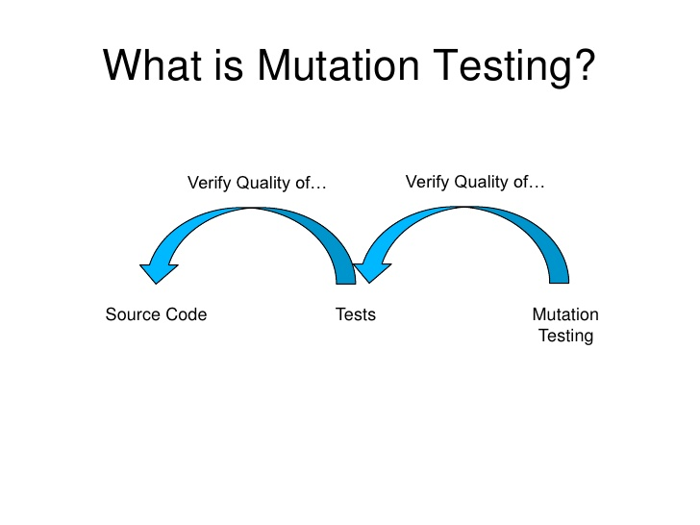

Slide 4
How does it work?

Slide 5
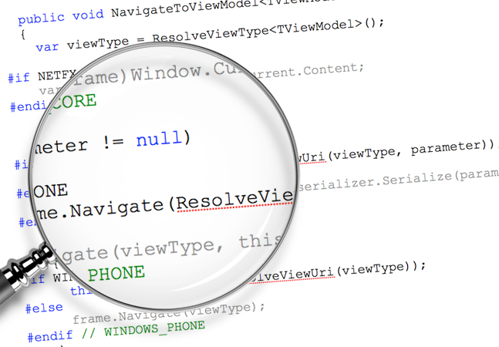
How does it work? (part 1)
First of all, mutation tool analyzes the source code for code where a mutation could possibly introduce a mutant.

Slide 6
Examples of possible mutations
bool result = value.isPresent() && (value > 50);
int result = item.calculatePrice() - item.calculateDiscount();
return createItem();

Slide 7
How does it work? (part 2)
When all the possible mutations are found the test suite are run against the mutated code to verify the state of the mutation.
There are two outcomes:
Mutant dies
Mutant survives

Slide 8
Demo

Slide 9
Summary

Slide 10
Summary
Mutation tool changes the source code with special “operators” to generate mutations
Test suite are run against the mutated sources resulting in two outcomes:
If a test fails => Mutant is ‘killed’
If all test cases pass => Mutant survives
Surviving Mutants shows the possible outcomes not covered by the test cases

Slide 11
Mutation testing tools
Mutant/Mutest for Ruby
Pitest for Java
Stryker for JavaScript
VisualMutator for C#
Sixty North for Python
Humbug for PHP

Slide 12
Questions?

